Slide 1
Data Structures

Slide 2
Agenda
Scanner
Some Problems
Sorting – Bubble, Insertion, Selection
Problems on Sorting

Slide 3
Scanner

Slide 4
Spiral Matrix Problem

Slide 5
Spiral Matrix Problem

Slide 6
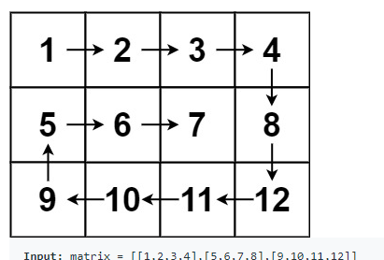

Slide 7
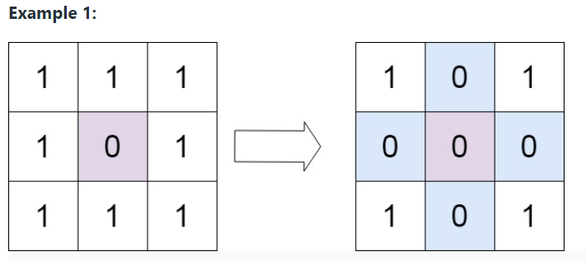
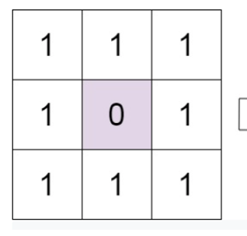
Set Matrix Zeroes Problem

Slide 8
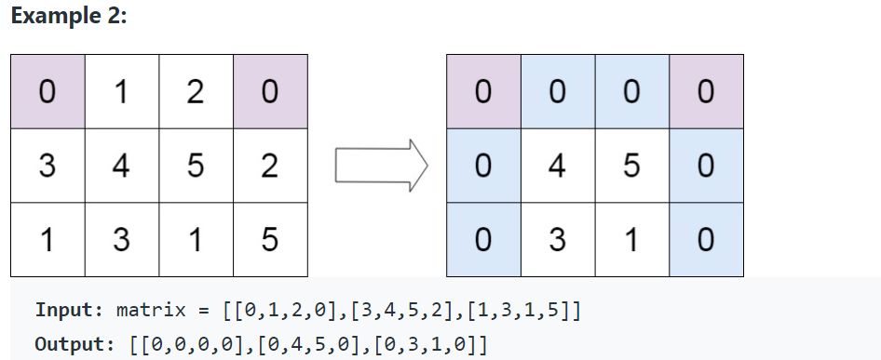
Set Matrix Zeroes Problem

Slide 9
Set Matrix Zeroes Problem

Slide 10
Set Matrix Zeroes Problem

Slide 11
Decode Ways Problem

Slide 12
Letter Combinations Problem

Slide 13
Generate Parenthesis Problem

Slide 14
Heater’s Problem

Slide 15
Sorting

Slide 16
Problems on Sorting

Slide 17
THANK YOU

